Slide 1
Constructor & Destructor

Slide 2
Constructor
Constructors are special class members which are called by the compiler every time an object of that class is instantiated.
Constructors have the same name as the class and may be defined inside or outside the class definition.
Constructors don’t have return type
If we do not specify a constructor, C++ compiler generates a default constructor for us (expects no parameters and has an empty body).
Constructors are used to initialize all class data members.
There are 3 types of constructors:
Default constructors
Parametrized constructors
Copy constructors

Slide 3
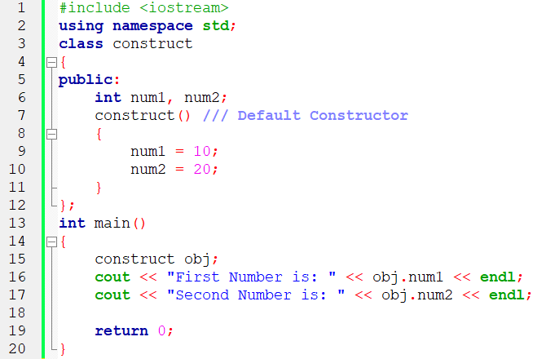
Default Constructors
Default constructor is the constructor which doesn’t take any argument. It has no parameters.

Slide 4
Parameterized Constructors
It is possible to pass arguments to constructors.
Typically, these arguments help initialize an object when it is created.
To create a parameterized constructor, simply add parameters to it the way you would to any other function.
When you define the constructor’s body, use the parameters to initialize the object.

Slide 5
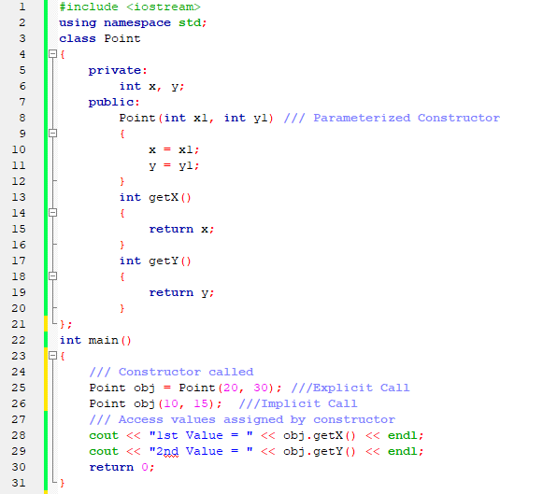
Parameterized Constructors

Slide 6
Uses of Parameterized Constructors
It is used to initialize the various data elements of different objects with different values when they are created.
It is used to overload constructors.
Can we have more than one constructors in a class? Yes, It is called Constructor Overloading.

Slide 7
Constructor Overloading
In C++, We can have more than one constructor in a class with same name, as long as each has a different list of arguments. This concept is known as Constructor Overloading.
Overloaded constructors essentially have the same name (name of the class) and different number of arguments.
A constructor is called depending upon the number and type of arguments passed.
While creating the object, arguments must be passed to let compiler know, which constructor needs to be called.

Slide 8
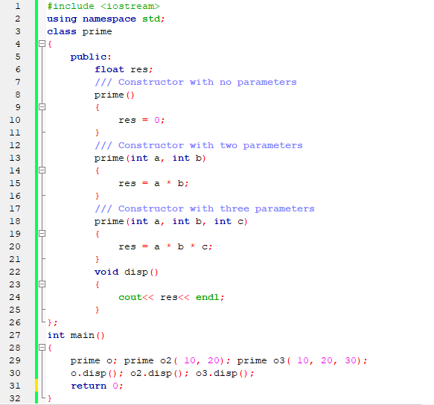
Constructor Overloading

Slide 9
Copy Constructor
A copy constructor is a member function which initializes an object using another object of the same class. A copy constructor has the following general function prototype:
ClassName (const ClassName & objName);

Slide 10
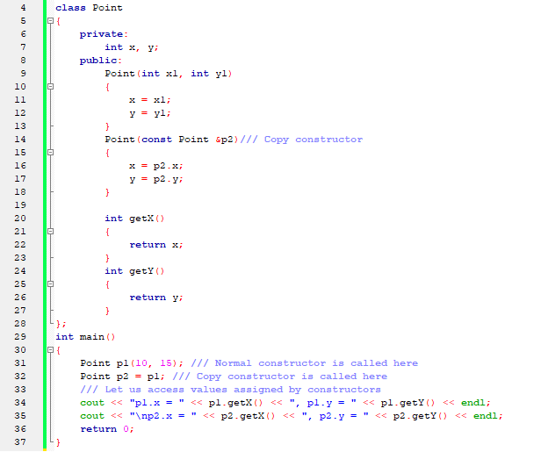
Copy Constructor

Slide 11
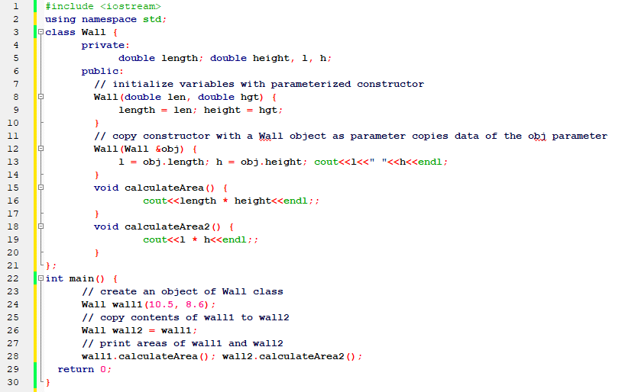
Copy Constructor

Slide 12
When is Copy Constructor Called!!!
When an object of the class is returned by value.
When an object of the class is passed (to a function) by value as an argument.
When an object is constructed based on another object of the same class.
When the compiler generates a temporary object.

Slide 13
Destructors
What is destructor? Destructor is a member function which destructs or deletes an object.
When is destructor called? A destructor function is called automatically when the object goes out of scope:
the function ends
the program ends
a block containing local variables ends
a delete operator is called

Slide 14
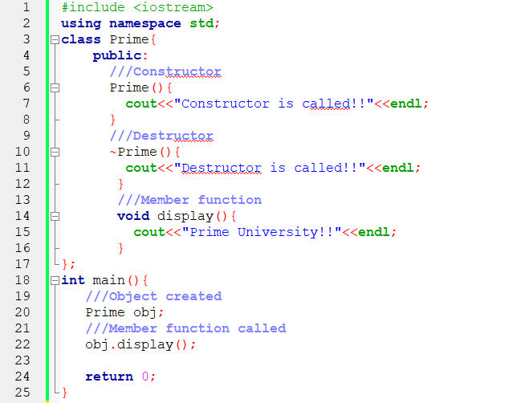
Destructors
How destructors are different from a normal member function? Destructors have same name as the class preceded by a tilde (~). Destructors don’t take any argument and don’t return anything

Slide 15
Thank You

